Slide 1
Probability and statistics Introduction
상명대학교 휴먼지능정보공학과
2022년 2학기

Slide 2
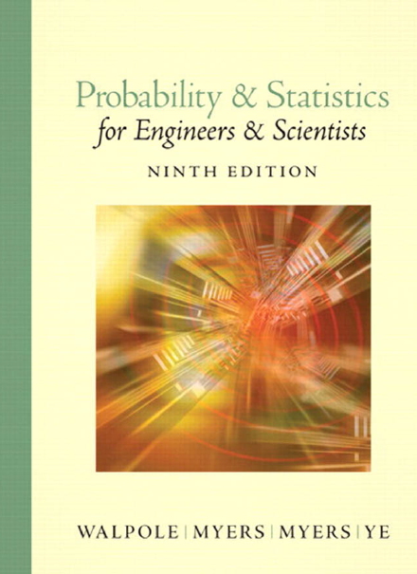
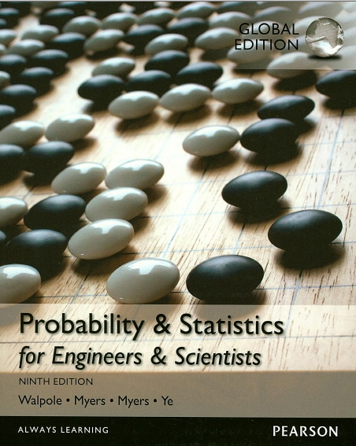
Overview
Course title : Probability and statistics
Background
Target: 1학년 2학기
Prerequisite: none
3 Credits
3 hours lecture
Text
Probability & statistics for engineers & scientists; Ronald E. Walpole et al. — 9th ed.

Slide 3
Overview
Grading Policy
Mid-term : 50 %
Final : 50 %
Lecturer
정진우 교수
미백관 418호
Tel: 02-2287-5452
jjoung@smu.ac.kr

Slide 4
Overview: Weekly plan
Introduction
Probability: Terminology and Examples
Conditional Probability, Independence, Bayes’ Theorem
Discrete Random Variables; Expectation
Variance; Continuous Random Variables
Continuous Expectation and Variance, the Law of Large Numbers, and the Central Limit Theorem
Joint Distributions, Independence Covariance and Correlation
중간고사
Introduction to Statistics
Bayesian Updating; Prediction and Odds
Frequentist Statistics and Hypothesis Testing; Null Hypothesis Significance Testing
Comparison of Bayesian and Frequentist Inference
Confidence Intervals; Bootstrapping
Linear Regression
기말고사

Slide 5
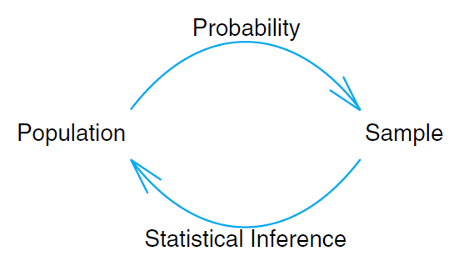
Introduction
population: 모집단
sample ≈ collections ≈ observations
elements in probability allow us to draw conclusions about characteristics of hypothetical data taken from the population (sample), based on known features of the population.
the sample with inferential statistics (추론 통계) allows us to draw conclusions about the population.

Slide 6
Example 1
100 items are sampled and 10 are found to be defective.
these 100 items represent the sample.
the population means all possible items from the process.
we can only tolerate 5% defective in the process.
Can we conclude the process is not acceptable?

Slide 7
Example 1 (continued)
Suppose we learn that if the process is acceptable, that is, if it does produce items no more than 5% of which are defective, there is a probability of 0.0282 of obtaining 10 or more defective items in a random sample of 100 items from the process.
In other words, even for an acceptable process, the sample obtained in the previous page would rarely occur.
Anyway, the result suggests that the process very likely is not acceptable.
→ Probability aids in the translation of sample information into something conclusive or inconclusive about the scientific system.
Sample & probability elements
Statistical inference technique
Conclusion about the population

Slide 8
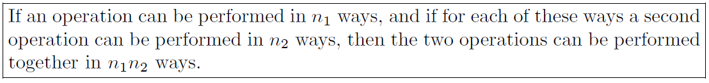
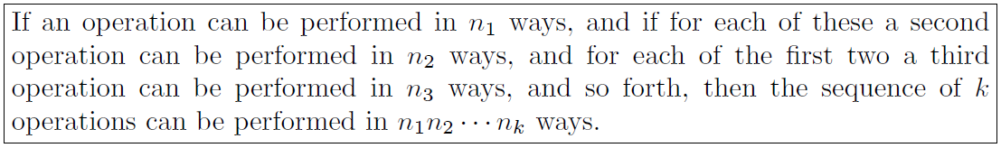
Rule of product
Rule of product

Slide 9
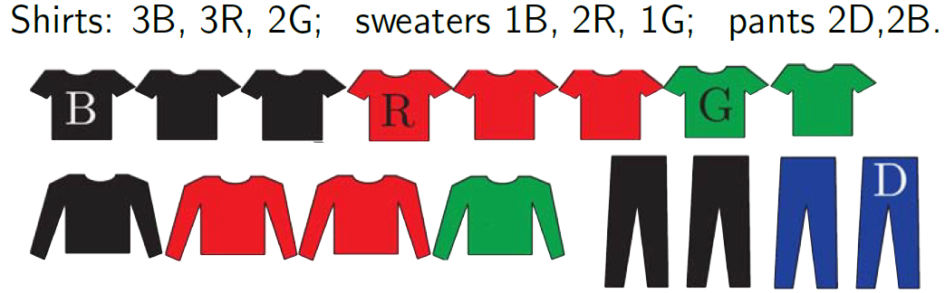
Example 2
Wardrobe (all different cloths)
Wear a shirt, a sweater, and a pants.
Do not wear green and red together.
How many different outfits?

Slide 10
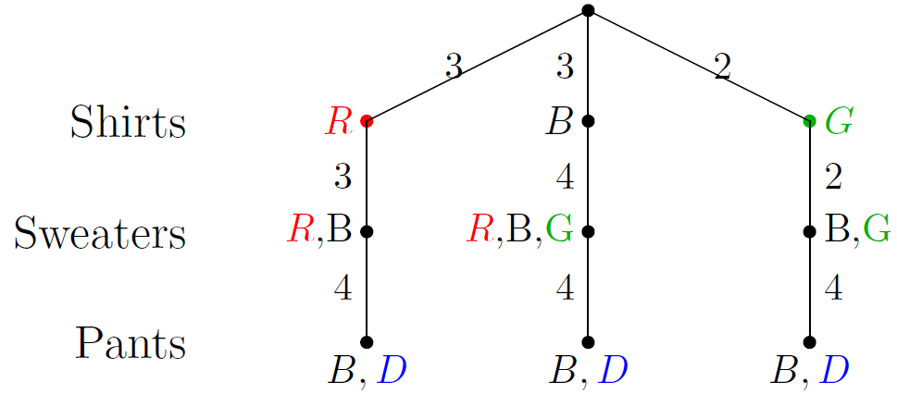
Example 2
Suppose we choose shirts first.
Depending on whether we choose red compatible or green compatible shirts there are different numbers of sweaters we can choose next.
So we split the problem up before using the rule of product.
A multiplication tree is an easy way to present the answer.
Number of outfits = (3 × 3 × 4) + (3 × 4 × 4) + (2 × 2 × 4) = 100

Slide 11
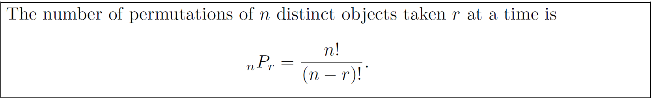
Permutation (순열)
Consider the three letters a, b, and c.
The possible permutations are abc, acb, bac, bca, cab, and cba.
There are 6 distinct arrangements, which is by the rule of product 3*2*1.
Now consider the number of permutations by taking two letters from four.
These would be ab, ac, ad, ba, bc, bd, ca, cb, cd, da, db, and dc.
There are 4*3 = 12 permutations.

Slide 12
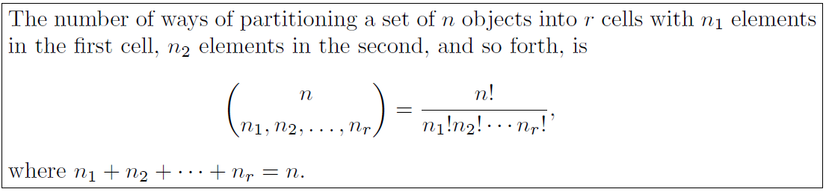
Partition
Partitions: the ways of partitioning a set of n objects into r subsets called cells.
A partition is achieved if the intersection (교집합) of every possible pair of the r subsets is the empty set φ and if the union (합집합) of all subsets gives the original set.
The order of the elements within a cell is of no importance.
Consider partitions of n objects into r cells with n1, n2, … nr elements. n1+n2+…+nr = n.

Slide 13
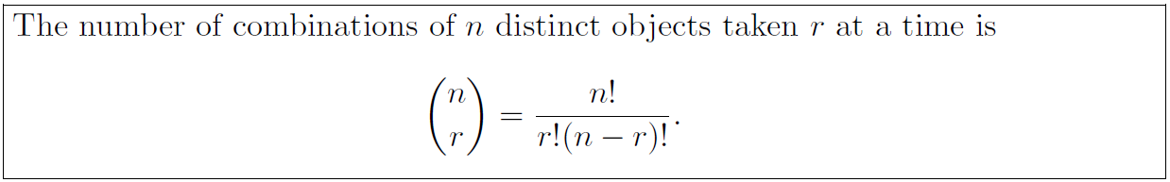
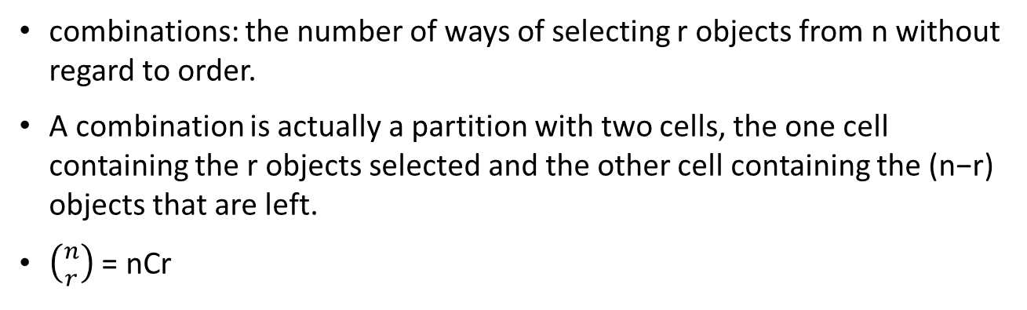
Combination (조합)
combinations: the number of ways of selecting r objects from n without regard to order.
A combination is actually a partition with two cells, the one cell containing the r objects selected and the other cell containing the (n−r) objects that are left.
$\left({n \atop r}\right)$ = nCr

Slide 14
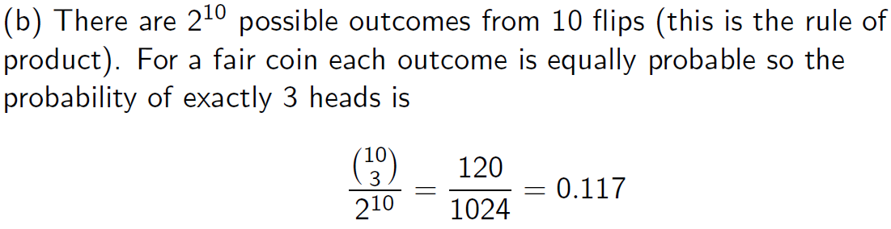
Example
(a) Count the number of ways to get exactly 3 heads in 10 flips of a coin.
(b) For a fair coin, what is the probability of exactly 3 heads in 10 flips?

Slide 15
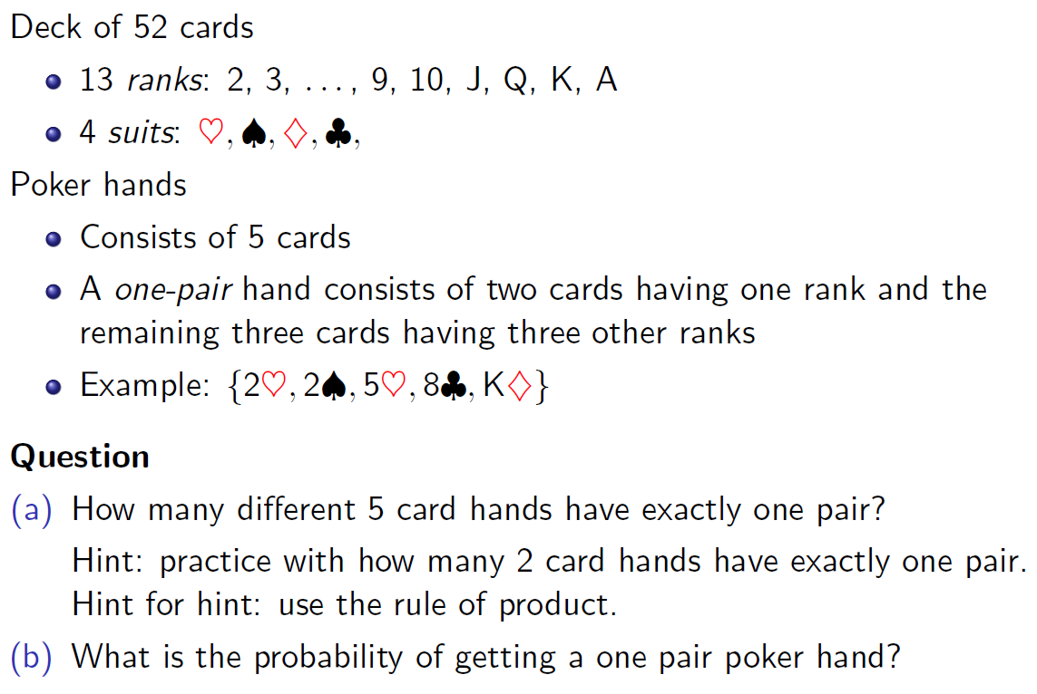

Slide 16
Answer to the Questions
We can do this two ways as combinations or permutations.
The keys are:
1. be consistent
2. break the problem into a sequence of actions and use the rule of product.
Break it into very small steps in order to make the process clear.

Slide 17
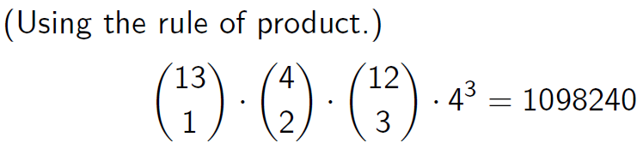
Answer: Combinations approach
Count the number of one-pair hands, where the order they are dealt doesn’t matter.
Action 1. Choose the rank of the pair: 13 different ranks, choosing 1, so 13C1 ways to do this.
Action 2. Choose 2 cards from this rank: 4 cards in a rank, choosing 2, so 4C2 ways to do this.
Action 3. Choose the 3 different ranks: 12 remaining ranks, so 12C3 ways to do this.
Action 4. Choose 1 card from each of these ranks: 4 cards in each rank so (4C1)^3 ways to do this.
To compute the probability we have to stay consistent and count combinations. To make a 5 card hand we choose 5 cards out of 52, so there are 52C5 = 2598960 possible hands.
Since each hand is equally likely the probability of a one-pair hand is 1098240/2598960 = 0.42257.

Slide 18
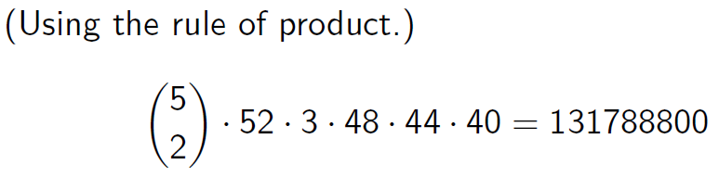

Answer: Permutations approach
Count the number of one-pair hands, where we keep track of the order they are dealt.
Action 1. (This one is tricky.) Choose the positions in the hand that will hold the pair: 5 different positions, so 5C2 ways to do this.
Action 2. Put a card in the first position of the pair: 52 cards, so 52 ways to do this.
Action 3. Put a card in the second position of the pair: since this has to match the first card, there are only 3 ways to do this.
Action 4. Put a card in the first open slot: this can’t match the pair so there are 48 ways to do this.
Action 5. Put a card in the next open slot: this can’t match the pair or the previous card, so there 44 ways to do this.
Action 6. Put a card in the last open slot: there are 40 ways to do this.
There are cards hands where order is important.
Thus, the probability of a one-pair hand is

